Slide 1
Database Fundamentals

Slide 2
Some definitions
Database
Collection of interrelated data items that are managed as a single instance
DBMS
Database Management System
Manages the databases

Slide 3
DBMS
Manages concurrent access to multiple databases
Manages transactions (all or nothing)
Supports queries
SQL in this course, and in most dbms’
Provides management of the database
Backup etc
Provides security
Who can access what?

Slide 4
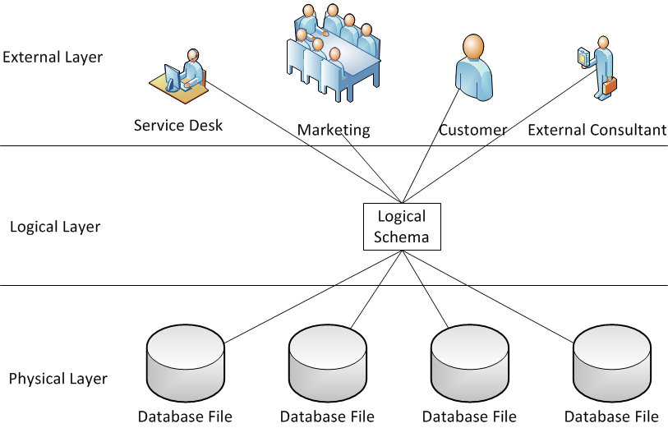
Abstraction
Present multiple users with their own distinct view of the data
User should not need to know how the data is being stored

Slide 5
Abstraction
Layers of Abstraction giving
Physical Data Independence
Logical Data Independence

Slide 6
Layers
Physical Layer
Multiple files on multiple disks
Logical Layer
Schema – gives structure to the data
External Layer
Users views
Subschema

Slide 7
Physical Data Independence
The ability to alter the way the files are stored without requiring any change in the Logical or External layer software
Most DBMS’ have this to some degree
DBMS catalogue keeps track of the location of the objects within the database
Good physical independence would include ability:
Move a file
Split or combine files
Rename files

Slide 8
Logical Data Independence
Ability to change the logical layer without disrupting users
Most logical changes also involve a physical change
Good logical data independence includes ability to
Add a new database object
Add data items to existing object

Slide 9
Aside: Design Abstraction
Data Model
A model of the data independent of any particular database
Database Model
A model of an implementation of a database
Should be based on a data model

Slide 10
Types of DBMS
Flat Files
Hierarchical
Network
Object Oriented
Relational
Object-Relational

Slide 11
Flat Files
Generally a single file
Common types:
Text (ascii)
Spreadsheet (Excel etc)
Often single file,
one row per record
“DBMS” may be part of user application
Are “Flat Files” actually databases?

Slide 12
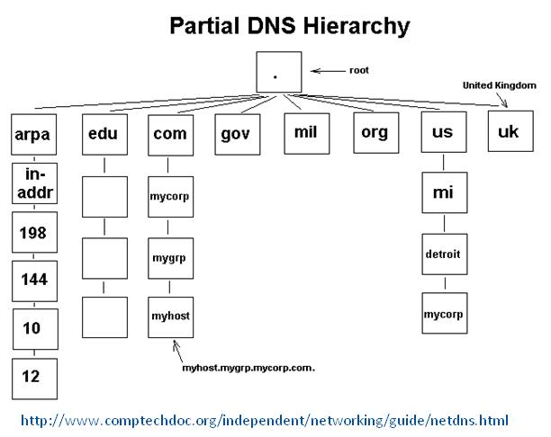
Hierarchical Model
Earliest formal database
Records stored in files, similar to directory tree in OS
Pointers between records forming a tree
One parent many children
DNS is a surviving example but is distributed
Not flexible
Ad-hoc queries are difficult

Slide 13
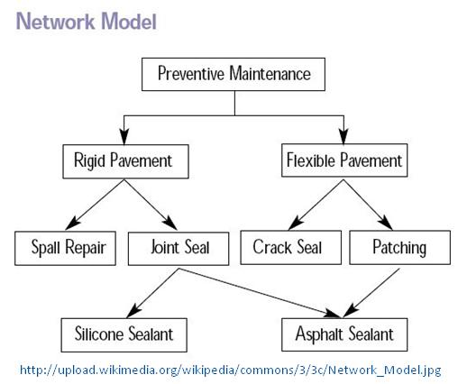
Network Model
Similar to hierarchical but allows many parents
Complex
Not flexible
Ad-hoc queries are difficult

Slide 14
Object Oriented Model
Merges software with databases
Stored or persistent objects
An object is a logical grouping of related data and logic that represents a real world thing
JADE, ZODB
Notes:
JADE is a non-relational database platform that the Data behaves as if it’s in memory, which makes interconnected object structures and data easy to store, retrieve, and scan.

Slide 15
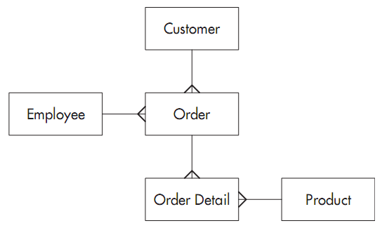
Relational
Table based
Data stored as sets
Thought of as columns and rows, but not necessarily stored that way
Starts with the assumption that the database designer cannot conceive of every possible use of the data
Designed to be flexible

Slide 16
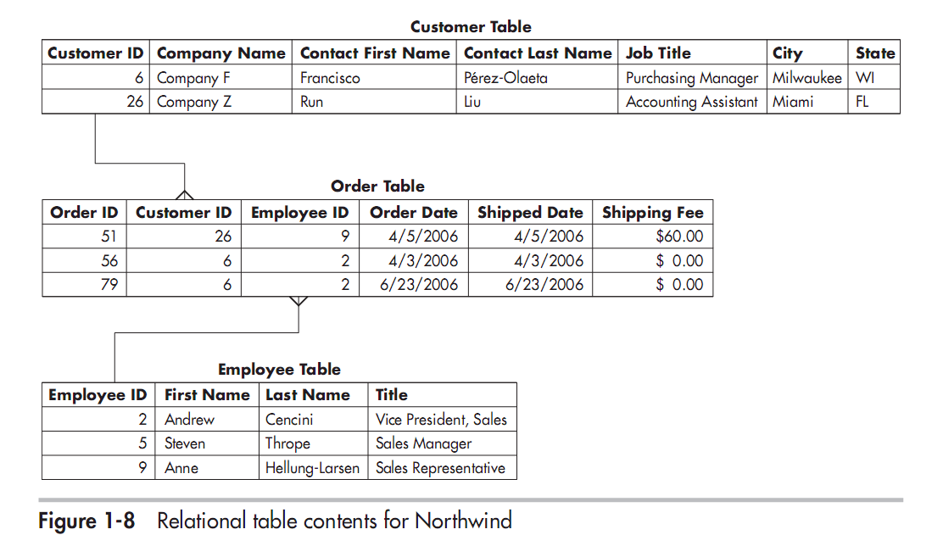
Relational Tables

Slide 17
Object-Relational
Combines flexibility of relational with encapsulation of data from OO.
May become more dominant.
PostgreSQL
Notes:
Note that PostgreSQL is typically used as a relational DBMS, but it does support many object-relational features.

Slide 18
Our Focus: Relational
Most common
Most flexible
Most generic
skills learnt on (say) MySQL / MariaDB are easily applied to other vendors e.g. Oracle, PostgreSQL, DB2 MSSQLServer etc
Other models tend to be unique implementations e.g. JADE skills not necessarily transportable to JODB (Java Objects Database)

